Slide 1
ARITHMETIC PROBLEM SOLVER
Team Members:
Tathagat Nawadia 1BI11CS074
Vikas Yadav 1BI11CS084
Soundarya Srinivas 1BI11CS110
Ramya R 1BI11CS111
Faculty In Charge:
Mrs M.S. Bhargavi
Assistant Professor
Department of CSE, BIT.

Slide 2
Agenda
Introduction
Problem Statement
Literature Survey
Proposed System
Architecture
Dataflow Diagram
Module Descriptions
Implementation Details
Testing
Snapshots
Applications
Conclusion
Limitations
Future enhancement
References

Slide 3
Introduction
Automated solutions to numerical questions is an open project which is still under research at various institutes.
Systems are capable of answering questions by searching an external resource without performing any computation.
Designing an Aptitude solver- machine that accepts , extracts, understands and solves an arithmetic aptitude question is a challenging problem
Most challenging task is to deal with different domains of aptitude questions and make machine to understand particular domain.
Important face of the processing is to understand and know different arithmetic and logical techniques and formulas that can be implemented on a particular domain and applying them to compute desired result.
The system should make rigorous analysis of training set and gives the closest output without referencing any external source.

Slide 4
Problem Statement
Efficient processing of aptitude questions of various domains to identify and solve domain specific aptitude problems accurately

Slide 5
Literature Survey
Title of the Research Papers | Year of Publication | Authors | Method Proposed
Question Answering System: A Survey | 2015 | Ashish Mathur and M.T.U. Haider | Information Retrieval (IR), Natural Language Processing (NLP) and Information Extraction (IE).
An Integrated Pattern Matching and Machine Learning Approach for Question Classification | 2015 | Vaishali Singh, Sanjay K. Dwivedi | Classifying a question to appropriate class and identification of the focus word play key role in determining accurate answer
Machine Learning for Question Answering from Tabular Data | 2011 | Mahboob Alam Khalid, Valentin Jijkoun | use a classiﬁer to identify appropriate tables and columns in a structured database

Slide 6
Proposed System
In this model, a user is asked to input a question from a terminal screen, the question is further sent for processing and the existing corpus is loaded to learn a generalized model
We identify the domain and pipe it to further clean the corpus as well as input question
Cache metadata and relevant information for a domain, if the cache is available, update cache and pipe it along to the domain specific scripts
Process natural language to get the best features of the question and TRY to map it to the variables in solving module

Slide 7
Architecture
Training Set
Document
Questions
FEATURE VECTOR
MACHINE LEARNING ALGORITHMS
LABELS
1.5
EXPECTED
OUTPUT
PREDECTIVE MODEL
FEATURE VECTOR
NEW PROBLEM
INSTANCE

Slide 8
Data Flow Diagram (General)
User
HTML CODE FROM EXTERNAL RESOURCE
1
EXTRACTED DATA
External Website
WEB
SCRAPING
APTITUDE PROBLEM
D1
EXTRACTED DATA
2
CLASSIFICATION
VARIABLES
and
OBJECTIVES
4
3
RESULT
LANGUAGE
PROCESSING
User
COMPUTATION
CLASSIFIED INPUT

Slide 9
Data Flow Diagram (Module 1)
Web
Executing Website Structure
1.1
Website Specific Structures
PARTIAL DOM NODES
DOM Parser
Extractor
1.2
Persistent DB
File Saver
Q1
1.3
Q2
Q3
FILE SYSTEM
Questions

Slide 10
Data Flow Diagram (Module 2)
Test
Set
Classifier Data Splitter
Frequency Distribution Analysis
2.1
2.2
Train
Set
FILE SYSTEM
Feature
Enhance
Label Result
NumPy Arrays
LABELED FEATURE
VECTOR
Machine Learning
Classifier Stack
Feature Vector Extractor
2.4
2.3
User
New Problem
Instance
QUESTION FEATURE

Slide 11
Data Flow Diagram (Module 3)
Cache Re-correction
Domain Specific File Reader
3.2
3.1
WRITEBACK
FILE SYSTEM
Abbr.
Cache
METADATA
EVALUATOR
FALLBACK
Units
Cache
Feature
Cache
Manual Correction Mode

Slide 12
Data Flow Diagram (Module 4)

Slide 13
Modules
Segmentation of face: The face is segmented from the input image that is initially whatever the video that is recorded by the camera will be fragmented into the frames and this frames will be given as inputs for segmenting the face.
Detection of Eyes condition: The position of the driver's eye is determined by using appropriate threshold. In this work, edge detection of the eyes region is considered.
Yawning Detection: Among clustering methods used in segmentation of various parts of the image, the mean-based clustering was utilized for yawning detection. The objective function was to obtain then minimum distance between the classes, or basically between the image pixels.

Slide 14
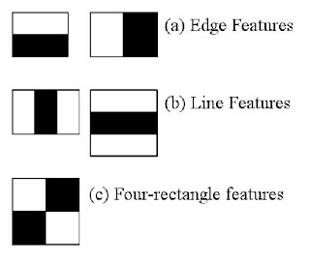
Viola Jones Algorithm
A widely used method for real-time object detection.
Rectangle_Feature_value f :
f= ∑(pixels in white area) – ∑ (pixels in shaded area)
If (f) is large, then it is face:
if (f)>threshold, then
face
Else
non-face

Slide 15
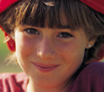

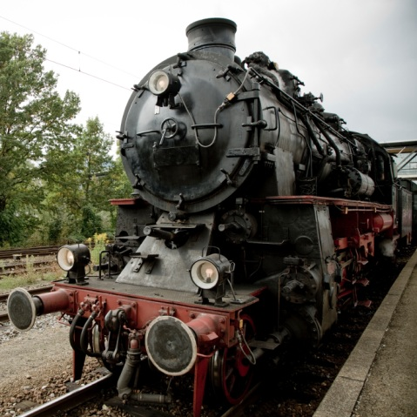

Viola Jones contd..
This is a face: The eye-area (shaded area)is dark, the nose-area
(white area) is bright.
So f is large, hence it is a face!
This is not a face. Because f value is small.

Slide 16
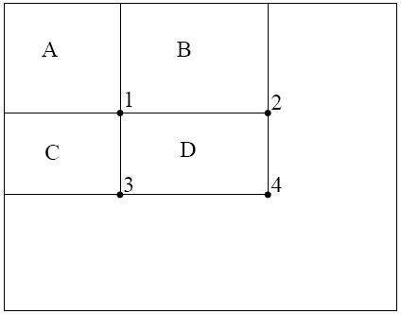
Viola Jones Algorithm
IMAGE
INTEGRAL IMAGE
0 | 1 | 1 | 1
1 | 2 | 2 | 3
1 | 2 | 1 | 1
1 | 3 | 1 | 0
0 | 1 | 2 | 3
1 | 4 | 7 | 11
2 | 7 | 11 | 16
3 | 11 | 16 | 21
The algorithm has mainly following stages:
Creating Integral Image
Adaboost algorithm
Cascaded Classifiers
Creating integral image:
Integral image value at a pixel (x, y) is the sum of the pixel values of the original image above and to the left of (x, y), inclusive.
The sum of the pixels within rectangle D can be computed with four array references.
The value of the integral image at location 1 is the sum of the pixels in rectangle A.
The value at location 2 is A + B, at location 3 is A + C, and at location 4 is A + B + C + D.
The sum within D can be computed as 4 + 1 - (2 + 3).

Slide 17
Viola Jones Algorithm (contd…)
Adaboost :Problem: Too many features
In a sub-window (24x24) there are ~160,000 features (all possible combinations of orientation, location and scale of these feature types).impractical to compute all of them (computationally expensive).
We have to select a subset of relevant features – which are informative - to model a face
Hypothesis: “A very small subset of features can be combined to form an effective classifier”
How?
AdaBoost algorithm
Stands for “Adaptive” boost
Constructs a “strong” classifier as a linear combination of weighted simple “weak” classifiers
Weak classifier
Strong classifier
Image
Weight

Slide 18
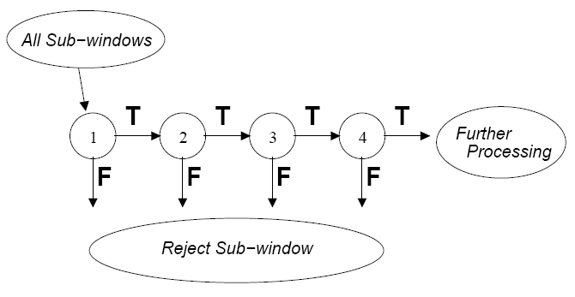
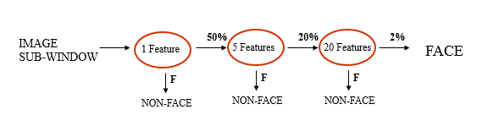
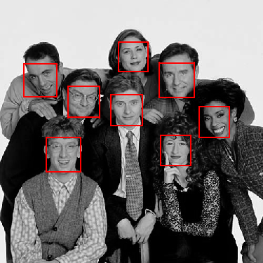
Viola Jones Algorithm
Cascaded Classifiers:
First of all the whole image is divided into sub windows. Each of the sub window must pass through the series of cascaded classifier as shown.The classifier can act as a 1st layer of a series to filter out most negative windows
2nd layer with 5 features can tackle “harder” negative-windows which survived the 1st layer, and so on…

Slide 19
Implementation
Here the proposed system includes following parts
1. Segmentation of face
2. Detection of eyes and its condition
3. Detection of mouth and its condition

Slide 20
Implementation(contd..)
Segmentation of face
This is the very first module in which the face is segmented from the input image that is initially whatever the video that is recorded by the camera will be fragmented into the frames and then into the image, this image will be given as input for segmenting the face.
Here we have to detect the face region out of the whole image. Face is our region of interest i.e the foreground object and rest is the background image. Face detection is done through Viola Jones algorithm that was explained in the previous slides.

Slide 21
Implementation(contd..)
Detection of eyes and its condition
Important factor which helps detect driver fatigue is the state of eyes, i.e. whether they are open or closed. We are locating the position of the eye in the frame taken from the drivers face. In the state of fatigue, eyelid muscles subconsciously attempt to accelerate the process of going to sleep.
Using this property, determining whether eyes are open or closed is done by relying on the difference of brightness intensity of the pupil in the image. Here, in this part
1. Eyes are detected.
2. Eyes are segmented from the face
3. Edge detection is done to detect the edges of the eyes

Slide 22
Implementation(contd..)
1. Eyes are detected: After detecting face the second step is to detect eyes from the face which is done through viola jones algorithm.
2. Eyes are segmented from the face: After eye detection eyes need to be segmented from the image for further processing.
i)eyes are segmented means both left eye and right eye are separated.
ii)these separated eye images are converted to grayscale for easier computation.
3. Edge detection is done to detect the edges of the eyes.

Slide 23
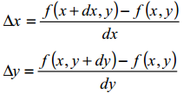
Implementation(contd..)
Find the gradient of the pixel.
The gradient is a vector, whose components measure how rapid pixel
value are changing with distance in the x and y direction

Slide 24
Implementation(contd..)

Slide 25
Implementation(contd..)
0 | 0 | 0 | 0 | 0 | 0 | 0 | 0
0 | 1 | 1 | 1 | 1 | 1 | 0 | 0
0 | 1 | 1 | 1 | 1 | 1 | 0 | 0
0 | 1 | 1 | 1 | 1 | 1 | 0 | 0
0 | 1 | 1 | 1 | 1 | 1 | 0 | 0
0 | 1 | 1 | 1 | 1 | 1 | 0 | 0
0 | 1 | 1 | 1 | 1 | 1 | 0 | 0
0 | 0 | 0 | 0 | 0 | 0 | 0 | 0

Slide 26
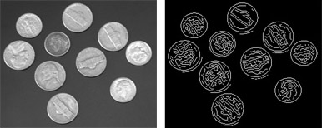
Implementation(contd..)
8. After the edges are detected the results are computed whether the eyes are closed or opened.

Slide 27
Implementation(contd..)
3.Detection of mouth and its condition
In case of mouth closure , two color spaces will be detected
In case of mouth open , three color spaces will be detected

Slide 28
Testing
Test case ID | Test Case | Input | Expected output | Obtained Output | Result
TID1 | Detecting face | Input Frame | Face detected | Segmentation of face | Pass
TID2 | Detecting eyes | Segmentation of face | Eyes detected | Edges of the eyes | Pass
TID3 | Detection of mouth | Closed eyes | Detected mouth | Clustered mouth with large hole | Pass
TID4 | Driver’s fatigue condition | Eyes open and Mouth closed | Non Fatigue | No Alarm | Pass
TID5 | Driver’s fatigue condition | Eyes closed and Mouth closed | Fatigue | Alarm generated | Pass
TID6 | Driver’s fatigue condition | Eyes closed and Mouth opened | Fatigue | Alarm Generated | Pass
TID7 | Driver’s fatigue condition | Eyes opened and Mouth opened | Fatigue | Alarm Generated | Pass

Slide 29
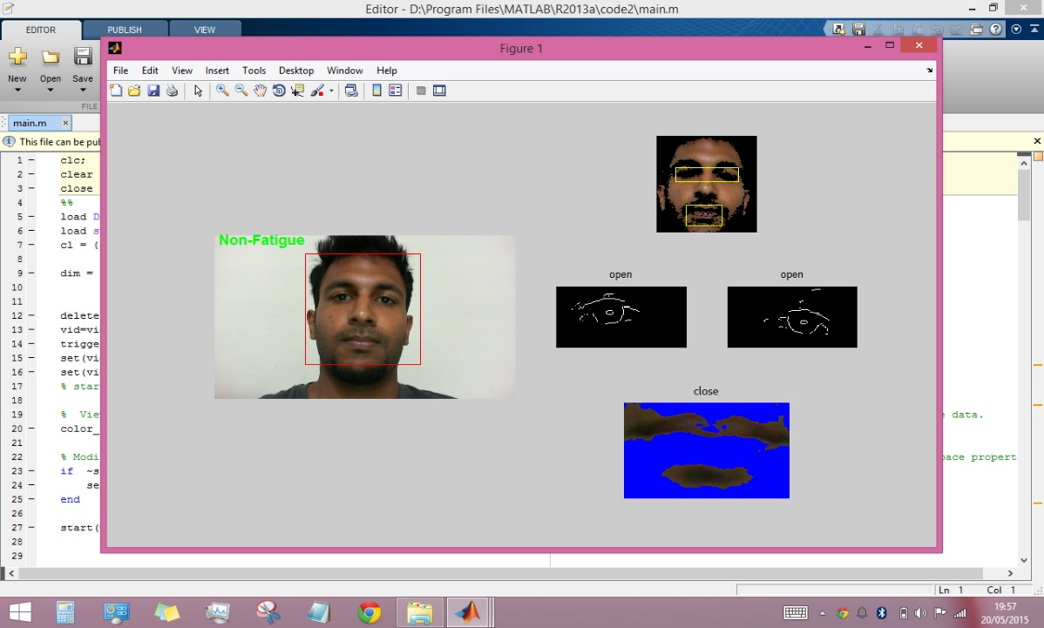
Snapshots
Snapshot for driver Non-Fatigue

Slide 30
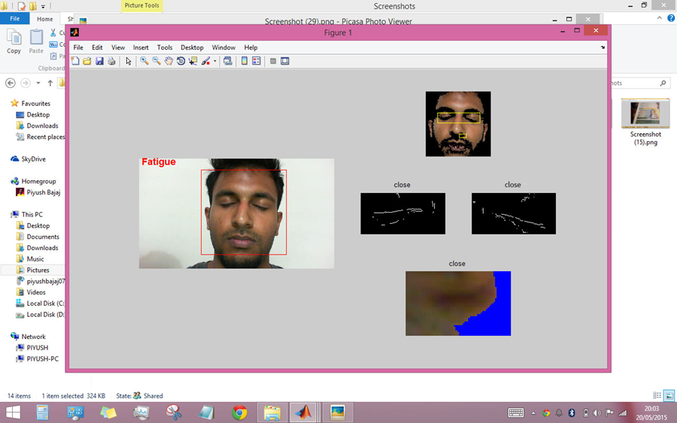
Snapshots(contd..)
Snapshot for driver Fatigue

Slide 31
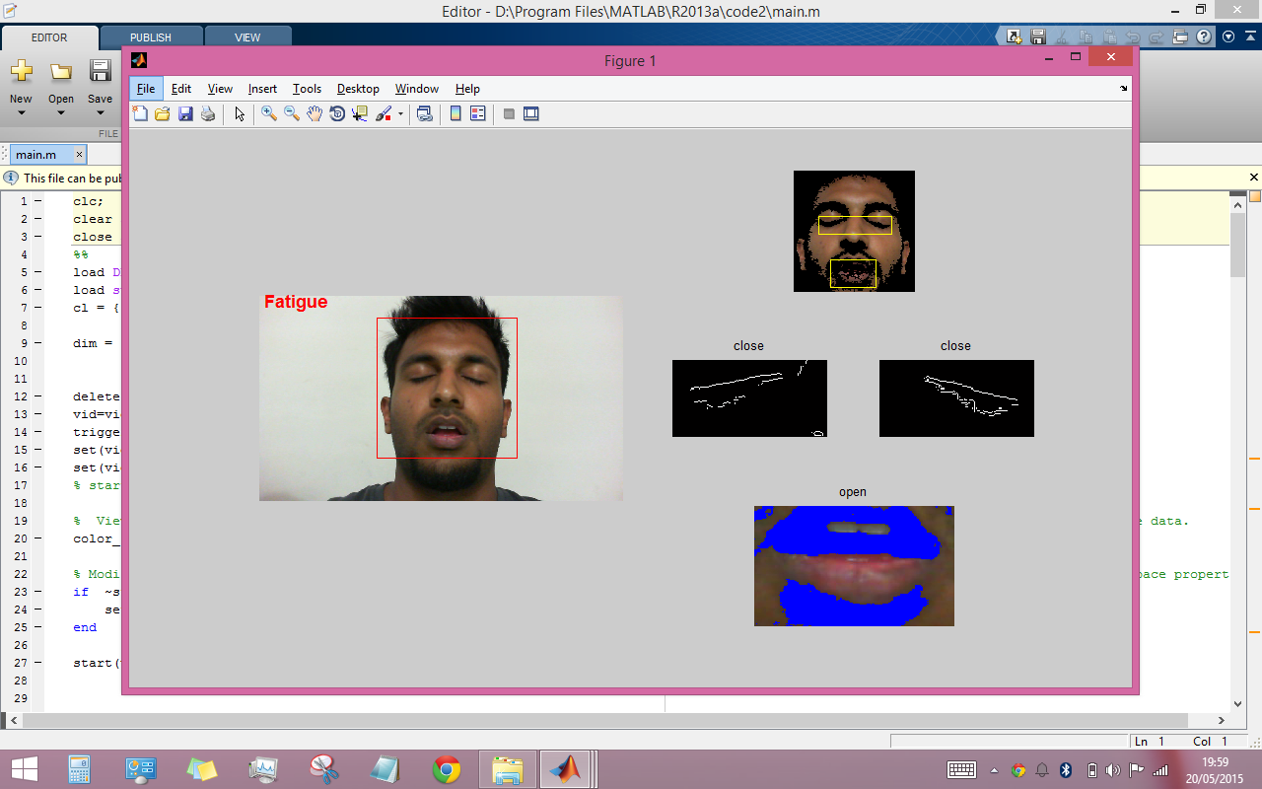
Snapshots(contd..)
Snapshot for driver Fatigue

Slide 32
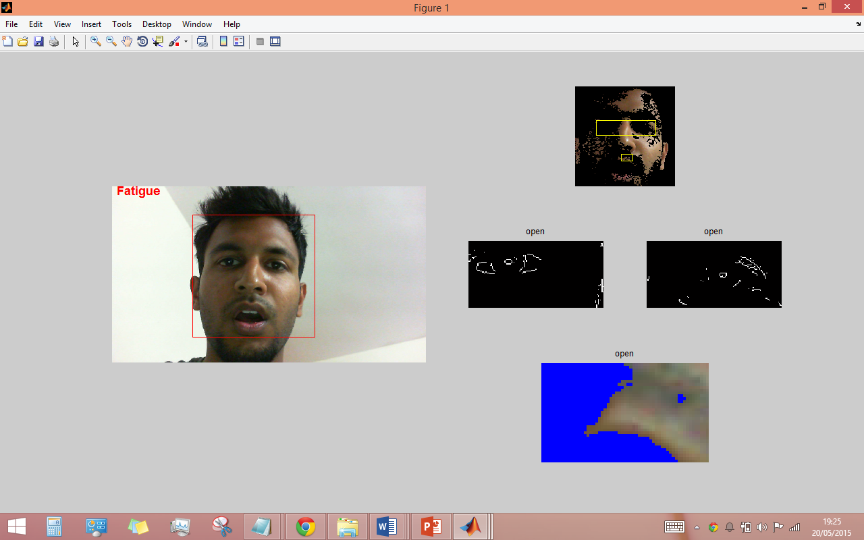
Snapshots(contd..)
Snapshot for driver Fatigue

Slide 33
Applications
Prevents the driver from falling asleep in long and solo trip.
System can also be used in other situation such as operators at nuclear plants , pilots of airplanes , security guards .

Slide 34
Conclusion
A non-invasive system to localize the eyes and monitor fatigue was developed.
During the monitoring, the system is able to decide if the eyes are opened or closed or if mouth is opened or closed. When the eyes have been closed for too long or mouth is closed a warning signal is issued.
The following conclusions were made:
• Image processing achieves highly accurate and reliable detection of drowsiness.
• Image processing offers a non-invasive approach to detecting drowsiness without the
annoyance and interference.
• A drowsiness detection system developed around the principle of image processing judges
the driver’s alertness level on the basis of continuous eye closures.

Slide 35
Limitations
System can’t be used in night
Accuracy compromised in low light conditions.

Slide 36
Future Enhancements
Efficiency can be improved by using infra red camera in low light conditions
System can be integrated with GPS to automatically stop processing when vehicle is not in motion.
System in near by proximity can interact to send signals to other driver in case any driver is in drowsy mode.

Slide 37
References
[1] A novel approach for drowsy driver detection using head posture estimation and eyes recognition system based on wavelet network. Teyeb, I, Res. Groups in Intell. Machines (REGIM-Lab.), Univ. of Sfax, Sfax, Tunisia ; Jemai, O, Zaied, M, Ben Amar, C.
[2] Efficient Method of Driver Alertness Using Hybrid Approach of Eye Movements and Bio-signals. Veena, S.L, Inf. Technol. Dept, Sathyabama Univ., Chennai, India.
[3] Driver drowsiness detection system. Alshaqaqi, B. Lab. Signals & Images (LSI), Univ. of Sci. & Technol. of Oran Mohamed Boudiaf (USTO-MB), Oran, Algeria Baquhaizel, A.S, El Amine Ouis, M, Boumehed, M, Ouamri, A, Keche, M.
[4] A new system for driver drowsiness and distraction detection. Sabet, M, Sch. of Electr. & Comput. Eng, Univ. of Tehran, Tehran, Iran, Zoroofi, R.A, Sadeghniiat-Haghighi, K, Sabbaghian, M.
[5] Various Approaches for Driver and Driving Behavior Monitoring: A Review. Hang-Bong Kang, Dept. of Digital Media, Catholic Univ. of Korea, South Korea.

